Slide 1
Summer Internship Project
Crimes Against Women in India – A Data Analysis Using Python
University Name :GIET Batch:194 Team Members :1.A.S.N.L.M.S.Srivalli[22551A05E1] Mentors:1.K.Meenakshi 2.B.Meghana[22551A05E4] 2.M.Ruthumma 3.D.Hyndavi[22551A05E9] 4.M.Mahesh[22551A05G9] Course : B.Tech-CSE

Slide 2
Contents
Introduction of Data analysis using Python and libraries
Project abstract
Introduction to Project
Technology Stack Used
System Design / Architecture
Implementation
Results / Output
Conclusion & Future Scope
References

Slide 3
Introduction
What is Data Analysis Using Python?
Data Analysis using Python is the process of inspecting, cleaning, transforming, and modeling data with the goal of discovering useful information, drawing conclusions, and supporting decision-making — all using Python programming.
Python is one of the most popular languages for data analysis because of its:
Simplicity and readability
Extensive libraries and community support
Powerful tools for statistical analysis and visualization

Slide 4
Key steps in Data Analysis with Python:
Data Collection: Gathering data from sources like CSV files, databases, APIs, or web scraping.
Data Cleaning: Handling missing values, correcting data types, and removing duplicates using libraries like Pandas.
Data Exploration: Understanding patterns and relationships in the data using NumPy, Pandas, and Seaborn.
Data Visualization: Creating plots, charts, and graphs using Matplotlib and Seaborn to make data easier to interpret.
Statistical Analysis & Modeling: Applying mathematical models and machine learning techniques using Scikit-learn to draw conclusions or make predictions.

Slide 5
Important Libraries used in Python:
NumPy – for efficient numerical computations and array manipulation
Pandas – for data cleaning, exploration, and manipulation
Matplotlib & Seaborn – for data visualization and pattern identification
Scikit-learn – for implementing machine learning models and predictive analytics

Slide 6
Project Abstract:
Aim: To analyze trends and patterns in crimes against women across India using data analytics techniques.
Data Source: State-wise and year-wise data obtained from the National Crime Records Bureau (NCRB).
Tools & Technologies Used:
Python for scripting and data analysis
Pandas for data cleaning and manipulation
Matplotlib and Seaborn for data visualization
Outcome:
Identification of year-over-year trends in crime rates
Detection of high-crime regions and vulnerable states
Insights to support data-driven decision-making and policy formulation for women’s safety in India

Slide 7
Introduction to Project
Crimes against women continue to be one of the most pressing social issues in India. Despite various legal frameworks and social initiatives, the rate of crimes such as rape, domestic violence, assault, and kidnapping remains alarmingly high in several parts of the country.
These crimes not only impact the physical and emotional well-being of women but also pose significant challenges to social justice, gender equality, and national development.
Scope of the Problem:
According to the National Crime Records Bureau (NCRB), thousands of cases are reported every year, with variations across different states and time periods.
Understanding where, when, and how frequently these crimes occur is crucial for effective intervention and policy response.

Slide 8
Need for Data Analysis:
Traditional crime reports often lack visual clarity and pattern detection.
Data analysis using Python libraries like Pandas, Matplotlib, and Seaborn helps:
Clean and organize large volumes of raw data
Uncover trends, correlations, and anomalies
Identify states or regions with consistently high crime rates
Value of Visualizations:
Graphs and charts simplify complex datasets, allowing lawmakers, NGOs, and citizens to quickly understand crime patterns.
Visual tools highlight urgent areas of concern, seasonality, and changes over time, which are not obvious from raw data alone.

Slide 9
Objective of the Project:
This project is intended to:
Raise awareness about the scale and seriousness of crimes against women
Provide data-driven support for policy decisions
Encourage preventive actions and targeted interventions in vulnerable regions
By leveraging data analysis, we aim to turn statistics into meaningful insights that can contribute to social change and improved safety for women across India.

Slide 10
Technology Stack Used
This project uses Python and its popular libraries to perform data analysis and visualization.
Programming Language:
Python – Easy to use, powerful for data analysis and visualization
Libraries Used:
Pandas – For loading, cleaning, and manipulating data
NumPy – For basic numerical operations and calculations
Matplotlib – For creating basic plots and graphs
Seaborn – For making advanced and attractive statistical charts
Scikit-learn (optional) – Can be used in future to apply machine learning models for prediction
Platform:
Jupyter Notebook and Google Colab Used to write and run code, view outputs, and create visualizations interactively

Slide 11
System Design / Architecture
The project follows a step-by-step workflow to analyze crime data effectively and extract meaningful insights:
Step 1: Data Acquisition
Crime data collected in CSV format from trusted sources such as NCRB and Data.gov.in
Contains year-wise and state-wise records of crimes against women
Step 2: Data Preprocessing
Pandas used to clean and structure the data
Tasks include removing missing values, renaming columns, and formatting data types

Slide 12
Step 3: Data Analysis
Apply grouping, filtering, and aggregation to explore crime patterns
Compare crime rates across years, states, and categories
Step 4: Data Visualization
Use Matplotlib and Seaborn to create:
Line plots – for trend analysis over years
Pie charts – for category-wise crime distribution
Box plots – for identifying variation and outliers
Step 5: Interpretation & Insights
Extract meaningful findings from the visualized data
Highlight high-risk regions, crime trends, and policy-relevant insights

Slide 13
Implementation
The implementation involved structured data processing, analysis, and visualization using Python and its libraries.
Data Loading
Imported the CSV dataset into a Pandas DataFrame for analysis
Data Processing
Executed over 20+ queries to:
Clean missing or inconsistent values
Filter data by year, state, and crime type
Group and aggregate data for meaningful insights

Slide 14
Aggregation Techniques Used
Common statistical functions applied:
min(),max()-Identify lowest and highest crime rates
mean(),mode()-Find average and most frequent values
var()-Measure data variability

Slide 15
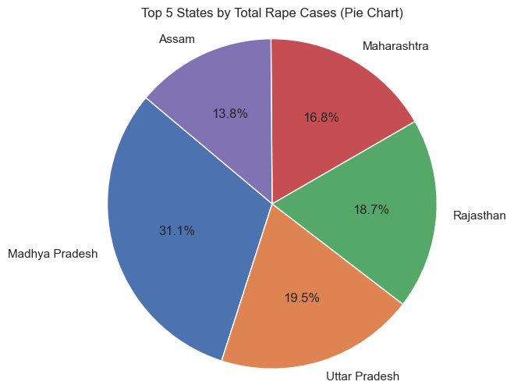
Data Visualization
Created multiple charts to highlight patterns and comparisons:
Pie Chart – Shows top 6 states with highest crime cases

Slide 16
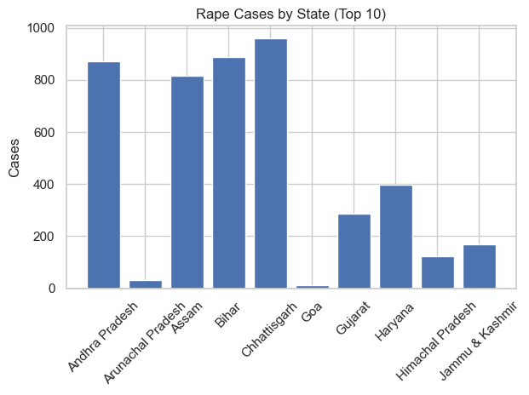
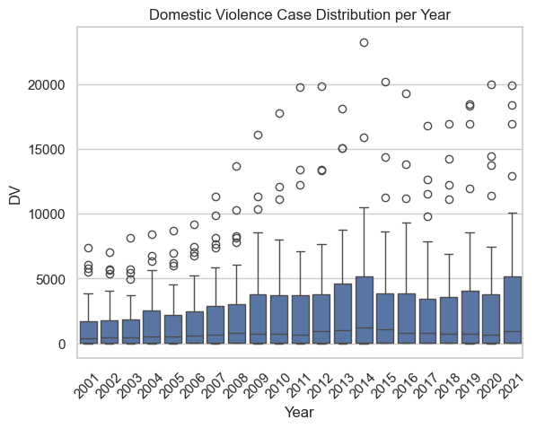
Bar Chart – Displays rape cases by state(top 10)year-wise
Boxplot-Visualizes spread and outliers in crimes against women categories

Slide 17
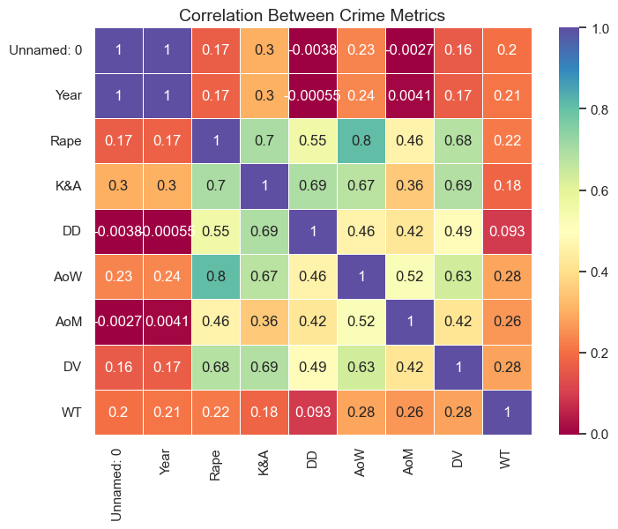
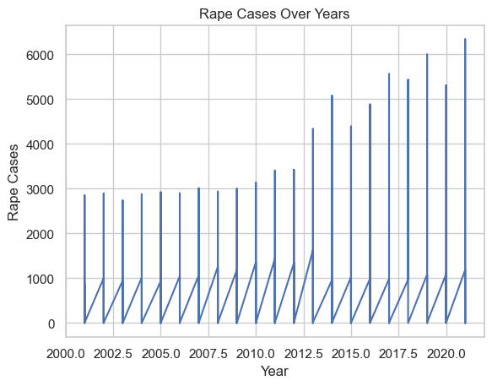
Heatmap – Correlation between different crime types
Line Chart – Trend of total crimes over the years

Slide 18
Results / Output
The analysis provided key insights into crimes against women across Indian states:
States like Uttar Pradesh and Maharashtra reported the highest total number of cases
Rape and Domestic Violence emerged as the most frequently reported crime categories
A rising trend in crimes was observed in several states over the years
Strong correlation identified between Assault on Women (AoW) and Domestic Violence (DV)
The pie chart visualization clearly highlights the top crime-contributing states, aiding in regional comparison

Slide 19
Conclusion & Future Scope
Conclusion:
Python libraries like Pandas, Matplotlib, and Seaborn enabled effective analysis of crime data
Visualizations simplified the understanding of trends and patterns across states and years
The insights can support public awareness, crime prevention strategies, and evidence-based policymaking
Future Scope:
Integrate demographic and socio-economic data (e.g., literacy rate, income levels) to enhance analysis
Implement predictive models using Scikit-learn to forecast future crime trends
Develop an interactive dashboard using Power BI or Tableau for real-time insights and stakeholder use

Slide 20
References
NCRB: Official crime data source
https://ncrb.gov.inData.gov.in
Government open data portal used for acquiring datasets
https://data.gov.in
Analytics Vidhya: Guidance on structuring Python data analysis projects
https://www.analyticsvidhya.com
Pandas Documentation: Reference for data manipulation and analysis
https://pandas.pydata.org
Seaborn Documentation: For creating statistical data visualizations
https://seaborn.pydata.org
Python Official Documentation: Language reference and standard library usage
https://docs.python.org
GitHub – AP Skill Development Internship Repository: Project-related code and analysis resources

Slide 21
Thank You

